Slide 1

Predict Titanic Passengers’ Survival Status
Yen Huynh

Slide 2
Methods:
Clean up Titanic dataset: missing values, non-numerical data into number values
Use two data science methods to compare which method gives better prediction:
Gaussian Naïve Bayes
Bernoulli's Naïve Bayes
Use K-means Model to classify the pattern of people survived based on their ages

Slide 3
Clean up:
Insert “family size” column by adding the number of passenger with their parents and siblings.
Drop columns that are irrelevant such as “cabin”, “body”, “home.dest”, “ticket”, “embarked”.
Use functions such as describe(), shape(), isnull(), dropna() to clean out necessary data.

Slide 4
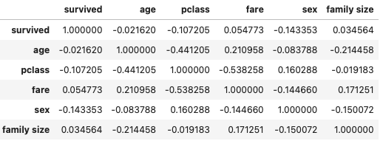
Naïve Bayes using Scikit-Learn:
Features that are correlated to each other:

Slide 5

Gaussian Naïve Bayes
Confusion matrix shows which values model predicted correctly vs incorrectly:
Predictive score of the model on the test data: 0.962

Slide 6
Bernoulli's Naïve Bayes
Confusion matrix shows which values model predicted correctly vs incorrectly:
Predictive score of the model on the test data: 0.990

Slide 7
Conclusion
Bernoulli's Naïve Bayes gives 99% score of accuracy at the end so based on accuracy score, we could use Bernoulli's Naïve Bayes over Gaussian Naïve Bayes.

Slide 8
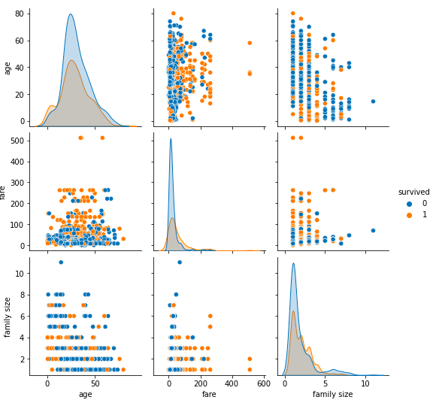
K-Means Clustering
Using pairplot() function with hue as “survived” to visualize the relationship between all the columns with people who survived and who didn’t.

Slide 9
Insight
People who pay fare less than $100 are most likely to die than people who pay more fare.
From the average age of people who pay less than 100 and more than 100 (relationship between age and fare), we can estimate the age of people who survive and not.

Slide 10
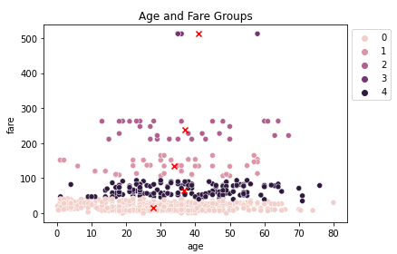
Cluster Analysis
Age and Fare groups cluster a pattern results:
lower fare, average age
low fare, younger age
high fare, average age
highest fare, older age
average fare, average age

Slide 11
Conclusions
People who paid more fare were richer and were most likely on first class, they would be prioritized to get on boats first compared to poor people who paid less fare and were on basement spots.

